Slide 1
Overview of Follow-up Visit Types and Visit Scheduling Training Binder Tab: Follow-up Visits

Slide 2
Scheduling Follow-up Visits
Ideally, follow-up visits will occur on the target day, at 28 day intervals from EV date
A follow-up visit schedule is fixed for each ppt (based on Enrollment date) and does not change based on actual visit completion date
If the visit cannot occur on the target day, it should be completed as close to the target day as possible and within the visit window
Visit windows are continuous, so each day in follow-up is always in a window

Slide 3
Target Days and Visit Windows – A Visual
Each visit window starts 13 days before the target day, and ends 14 days after
Month 1
Visit Window
Month 2
Visit Window
Month 3
Visit Window
-13 Days
+14 Days
-13 Days
+14 Days
-13 Days
+14 Days
Target Day
Target Date
Target Date
Target Day = 28 Day 56 Day 84
Notes:
Visit Windows for each month are 13 days prior to and 14 days after the target date and are contiguous for ASPIRE. Follow-up Visits can occur at any time within their respective visit windows, however, it is ideal if the monthly visits are as close to 28 days apart as possible.

Slide 4
Visit Codes
Why are they used?
To indicate at which point in a ppt’s trial participation an event occurred
Helpful when reviewing reports and conducting study analyses
Knowing that a ppt had a grade 2 AE on 23-SEP-12 doesn’t tell us much; knowing this is her Month 2 visit does
Visit Code = Visit Month
The visit month number is the Visit Code
Month 1 = Visit Code 01.0
For the most part, study staff do not have to record a Visit Code for the SV (97.0) or EV (98.0)
PUEV and Termination Visit do not have unique visit codes

Slide 5
Visit Codes/Visit Months Example
Visit | Visit Month | Visit Date
Screening | 97.0 | March 2013
Enrollment | 98.0 | April 2013
Month 1 | 01.0 | May 2013
Month 2 | 02.0 | 1 June 2013
Month 3 | 03.0 | July 2013
Month 4 | 04.0 | August 2013
Month 5 | 05.0 | September 2013
Month 6 | 06.0 | October 2013
Month 7 | 07.0 | November 2013
Month 8 | 08.0 | December 2013
Month 9 | 09.0 | January 2014
Month 10 | 10.0 | February 2014
Month 11 | 11.0 | March 2014
Month 12 | 12.0 | April 2014
Month 13 | 13.0 | May 2014
Month 14 | 14.0 | June 2014
Month 15 | 15.0 | July 2014
Month 16 | 16.0 | August 2014
Notes:
In June 2014, the Study Management Team decides that the study has reached the endpoint targets in order to achieve the study primary objectives and instructs sites to start PUEVs for each study participant starting from July 1st.
In this example, the participant’s Month 15 visit in July 2014 will be her PUEV. This visit will not have a specific PUEV visit code, but will be a continuation of her visit schedule. The visit code for each participant’s PUEV will vary depending on where she is at in her visit schedule. For this participant, instead of conducting a quarterly visit, the site will conduct all procedures for her PUEV. This participant’s study exit/termination visit code will be 28 days later in August and the visit code will be 16.0

Slide 6
Visit Calendar Tool
An Excel file that can be used to create the follow-up visit schedule/calendar for a ppt with actual dates
available @http://www.mtnstopshiv.org/node/3672
Requires the ppt’s PTID and her full Enrollment Date
For each required follow-up visit, the target date, date visit window opens, and date visit window closes are generated
Also has blank columns for site to write-in scheduled and actual visit dates
For easy reference, print and placed in the ppt’s study notebook once ppt has enrolled

Slide 7
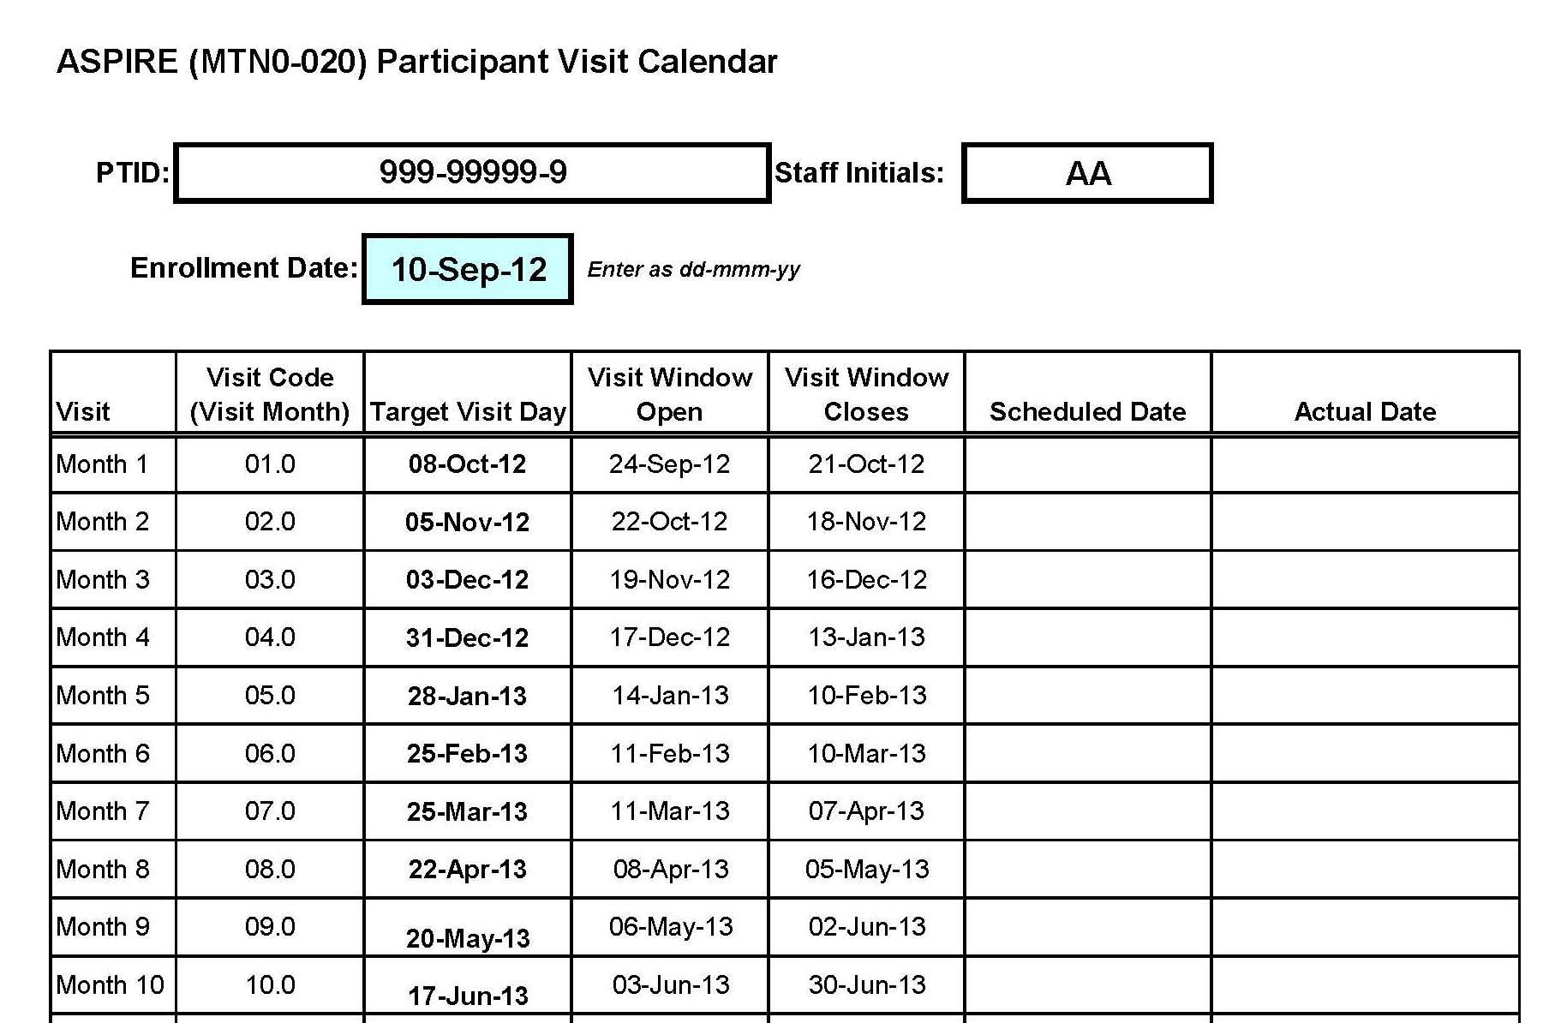
Visit Calendar Tool – Output (also in PTD)

Slide 8
Missed Visits
A follow-up visit is missed once the window for the visit closes and the ppt has not completed any part of the visit
Ex.: A participant completes her Month 1 Visit, but then does not contact the clinic again until she appears in-person on Day 73
Since the Month 2 window closed on Day 70, the ppt
has missed her Month 2 visit

Slide 9
Missed Visits
Missed Visits are documented in the study database using the Missed Visit CRF
Do not complete or fax any other CRFs for the missed visit
Protocol Deviation Log not completed/required
The Missed Visit form will let DataFax/SCHARP know not to expect any other forms for that participant with that visit code.

Slide 10
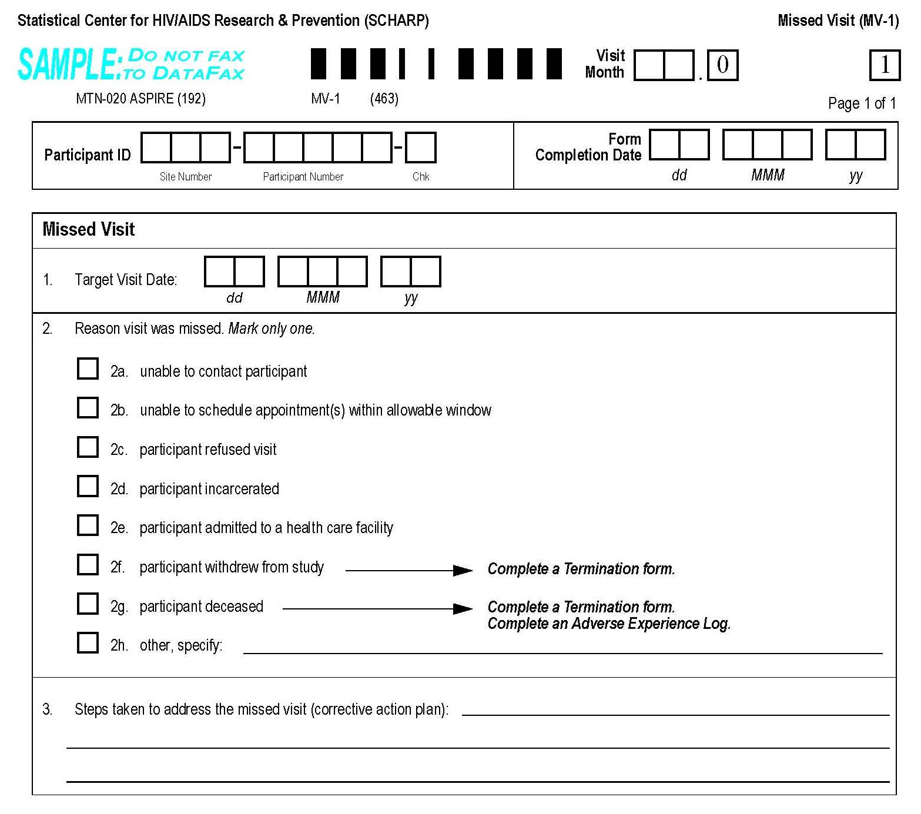
Missed Visits Form – New Item 3
Visit Month is hard-coded with “.0” at end
Target date is per ppt calendar
New item 3 = corrective action plan
Notes:
Missed visit CRF is in the ‘Follow-up Visits’ tab in the training binder (right before the green notes pages)

Slide 11
Interim Visits
An interim visit = a visit/contact that occurs between required (monthly) follow-up visits
Required monthly/quarterly/semi-annual visit procedures are not conducted
Either not needed (required visit already completed) or not the purpose of the visit
Ex. A ppt completes Month 6 on the target day and comes back 5 days later as requested for follow-up of an abnormal pelvic exam finding
Ex. A ppt completes Month 3 on the target day, and comes to the clinic 15 days later to report a new symptom
Ex. A ppt phones to report a new AE

Slide 12
Interim Visit Documentation
Interim Visits are documented like required follow-up visits, using the Visit Summary CRF
There is no Interim Visit CRF for ASPIRE
The interim visit code on the Visit Summary CRF will let us know it is an interim visit, along with a “yes” to item 5
Since we don’t know the reason for the interim visit or what CRFs were complete, we will need you to tell us (VS-1 items 5a, 5b)
Visit Summary CRF items 6 and 7 are left blank for interim visits

Slide 13
Interim Visit Codes
If the interim contact results in at least one newly-completed DataFax CRF, the interim visit is assigned an interim visit code
Interim visit codes use the box to the right of the decimal point – assign starting with .1
For the numbers to the left of the decimal point, use the visit month of the most recently-required visit, even if the interim visit date is in the next visit’s window
The interim visit code will be a number in-between the two visit months when the interim visit occurred
Ex.: A ppt has an interim visit 7 days after her Month 6 visit to draw labs; visit code = 06.1 (in-between Months 6 and 7)
Notes:
Note: Interim visits completed between the Enrollment Visit and Month 1 will have interim visit codes starting at 98.1

Slide 14
Split Visits
A visit is a split visit when the required visit procedures are split (done) over 2 or more days
The days must all fall within the visit window; any required procedures not done within the visit window are missed procedures
For split visits, only 1 Visit Summary form is completed, and the Visit Date on this CRF is the date of the first part of the split visit
All CRFs completed for the split visit are assigned the same visit code (ex. 12.0)
Can interim visits be split?

Slide 15
Let’s Talk PUEV and Early Termination…….

Slide 16
PUEV Timing and Required Procedures
Product Use End Visits will take place at the end of the study, during the same calendar month for ALL participants
The PUEV is not when a ppt is permanently discontinued from product prior to study end
When PUEVs will happen for all ppts will be determined based on HIV endpoints
Possible scenario: in June 2014, it is determined the study has enough HIV endpoints
Starting on Aug 1, 2014, each required visit will be conducted as a PUEV for each ppt
No special visit code; Visit Month = Visit Code
No special CRF; will use Visit Summary and mark in item 4/4a that it is the ppt’s PUEV

Slide 17
Scheduled Study Exit/Termination
Main purpose is to assess for delayed HIV seroconversion after product use has ended
Will occur 4 weeks after the PUEV, at the next regularly-required visit
Example: The ppt’s Month 22 is her PUEV. Month 23 is her scheduled study exit/term. visit
No special visit code; Visit Month = Visit Code
No special CRF; use VS-1 items 4/4a
HIV-infected ppts will not completed this visit (no need to assess for delayed seroconversion)
Since there is no Sample 2 collection, there should not be any post-termination visits requiring CRFs

Slide 18
Early Termination Visits
Will occur if a ppt withdraws consent
If consent withdrawn, complete as many of the Early Termination visit procedures as possible
Early Term. = PUEV + Study Exit/Term. Procedures
Use Early Termination CRF form packet; refer to Early Termination Visit in Schedule of Forms (Data SSP Section)
Mark “early termination” on Visit Summary CRF item 4a
Ppt should not be contacted for future visits, but do ask them if they want to be contacted when study results are available

Slide 19
Follow-up Visit Scenarios for Discussion
Scenario 1
A ppt completes her Enrollment Visit, and comes back one week later to report a new AE.
Q. What type of visit is this? What visit code is assigned? What CRF is used to document the visit?
A. This is an interim visit, documented with a Visit Summary CRF coded as 98.1 (in addition to any other CRFs).

Slide 20
Follow-up Visit Scenarios for Discussion
Scenario 2
A ppt comes in 12 days before her scheduled Month 8 visit (scheduled for target day). She says she will come back for her Month 8 visit as scheduled, but needs more condoms today.
Q. If only condoms are provided, are any CRFs needed for this visit? If so, which ones and what visit month is used?
A. No CRFs needed since no new CRFs completed for this visit. Chart note only. Site can complete Month 8 if they want, but it is better to wait until the target day if ppt is reliable.

Slide 21
Follow-up Visit Scenarios for Discussion
Scenario 3
A ppt comes in for her Month 13 visit and says she will complete her visit that day, but will then withdraw her consent as she no longer wishes to take part in the study.
Q. What CRFs are completed for the visit?
A. Complete CRFs in the Early Termination packet. On the Visit Summary, mark that this is an early termination visit.

Slide 22
Case Report Form Supply
CRFs will not be shipped from SCHARP; sites are responsible for CRF supply
Two options for CRF supply
Print from pdf files located on Atlas
Photocopy from hard-copy CRFs provided in Master Forms Notebooks (1 per site)
CRFs are available in visit packets and as a single PDF form set
Some CRFs (i.e. local-language CRFs) will need to be added to certain visit packets per packet cover page
Best option is to print rather than photocopy if possible; either way, test fax needed
Notes:
We will provide sites with an initial shipment of CRFs while they are getting processes in place to print CRFs during the remainder of the study
Recommend: 100g/m2 paper weight (90g/m2 seems to be an ok weight as well)

Slide 23
Follow-up Procedures

Slide 24
Visit Types
Notes:
Each participant will also have a Product Use End Visit and participants who have not seroconverted during the study will have a termination visit 28 days after their PUEV.

Slide 25
Follow-up Procedures
Administrative:
Review/Update Locator
Schedule Next Visit
Reimbursement
Clinical:
Medical/Menst. History
Concomitant Meds
Provide Test Results
Record/Update AEs
Contraceptive provision*
Treatment/referrals*
Physical Exam
Pelvic Exam
Lab:
Urine:
Pregnancy
Urine culture*
GC and CT
Blood:
HIV Serology
Syphilis Serology*
CBC with platelets
Serum Chemistries
Plasma Storage
Pelvic:
Vaginal Fluid (self)
Herpes Lesion*
Wet mount-Candidiasis*
Wet mount-BV*
Rapid Trichomonas
Vaginal pH
Gram stain
Endocervical swab
Behavioral (Counseling):
HIV pre- and post-test
HIV/STI risk reduction
Contraceptive
Adherence
Study Product/Supplies:
Condoms
Remove/Collect VR
Provide new VR
Digital Exam (M1)*
VR instructions*
Bottle of Water*
Behavioral (Assessments):
Adherence
Behavioral
Acceptability
Social Harms
ACASI (M3)
Notes:
THEME = Visit procedures build on each other…
Monthly = BLUE (procedures that are if indicated are grey).
Click, Adds Quarterly = RED. Quarterly visit procedures include all monthly visit procedures, plus:
Behavioral and acceptability assessments
Social harms assessment
ACASI (Month 3 visit only)
Physical exam
Blood for serum chemistries, CBC with platelets and plasma archive
Click, Adds Semi Annual = GREEN. Semi-Annual visit procedures include all monthly and quarterly visit procedures, plus:
Pelvic exams, including pelvic sample collection and rapid test for Trichomonas
Urine NAAT for GC/CT
Special Cases: Digital Exam at M1, ACASI at M3, Social Harm – formally assessed quarterly, but documented as happens if occurs at different visit type (difference from VOICE), bottle water only if relevant to site
*Clarify that procedures can be done if indicated at monthly visits (i.e. pelvic, physical).

Slide 26
Make-up of Missed Procedures
Missed Quarterly:
Physical exam
Missed Semi-Annual:
[Quarterly Procedures]
Pelvic exam
CBC with platelets
Blood chemistries
Plasma storage
NAAT for GC/CT
Pelvic samples (Trich, pH, gram stain, endocervical swab)
Make up at next visit (sched. or interim)
Notes:
If a scheduled quarterly or semi-annual visit is missed (and the visit window is closed), the listed procedures should be completed at the participant’s next clinic visit (scheduled or interim). Only the procedures listed above are required to be made-up at subsequent visits. Data from questionnaires (e.g. behavioral assessment CRFs, and ACASI questionnaires) will not be made-up.
If the visit window has not closed, could conduct as part of a split visit.
Could prompt = What system does your site use to track making up missed procedures?

Slide 27
Activity: Making Connections
Notes:
Participants will be put into groups for a brief activity which will link follow-up study procedures to study objectives/endpoints.
Activity Intro (total time ~ 15-20 min):
Pass out study objective handouts. Work with the person sitting next to you (pairs).
Turn to page 34 in your protocols (lists all follow-up study procedures)
On your worksheet under each objective, list what data collection procedure(s) contribute to each study objective (think endpoints). We will do the first as a group as an example (effectiveness); study procedure = HIV testing. Questions?
Once example is completed, ask groups to complete the rest of the worksheet.
Time permitting, revisit each objective and list the frequency of the data collection procedure.
Time permitting, revisit each objective and list other study procedures that support/supplement achieving each study objective.
Activity Debrief (can prompt group for observations, or just summarize for them if short on time):
The evaluation of the primary objective of safety has by far the most data collection associated with it (complete and accurate collection of AEs is critical to determining if the study product is safe to use).
Some study endpoints contribute to more than one study objective (i.e. HIV testing).
Some endpoints are assessed more frequently than others (primary objectives = monthly; other objectives might be less frequent)
If only some procedures contribute to endpoints why do we conduct these other procedures? Discuss supporting procedures/standard of care. Every study procedure during follow-up contributes to achieving our study objectives (whether endpoints, or supporting procedures). For example, adherence counseling and all study product related procedures are important for supporting correct product use and promoting high adherence. Study product use is critical to every single objective.

Slide 28
Activity: Making Connections
Work with the person sitting next to you
Turn to page 34 in your protocols for list of follow-up study procedures
On your worksheet under each objective, list what data collection procedure(s) contribute to each study objective (think endpoints)

Slide 29
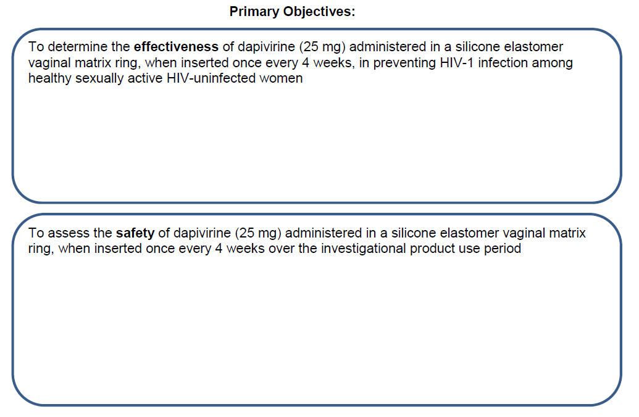
HIV Testing-rapids, WB, in some cases RNA and DNA
Record/Update AEs
Medical/Menstrual History
Physical Exam
Pelvic Exam
Blood Tests (hematology, chemistry)
Urine Tests
Tests for STI/RTIs
Notes:
Endpoints (from protocol):
Effectiveness: HIV-1 infection as measured by seroconversion at the end of the investigational product use period with seroconversion defined by the algorithm in Appendix III
Safety: Grade 2 adverse events (AEs) judged to be related to study product, Grade 3 and 4 AEs, All serious adverse events

Slide 30
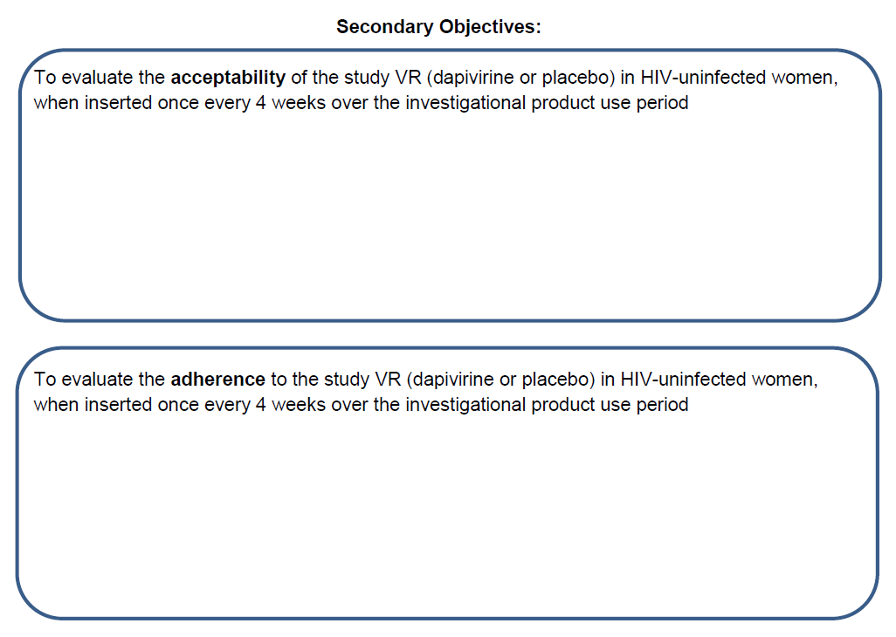
Behavioral Assessments (questionnaires, ACASI)
Adherence Assessment (RA-1 CRF)
Vaginal Fluid (self-collection)-PK testing
Plasma Storage-PK testing
Ring Collection (LoA#2)-Biofilms
Notes:
Acceptability: Participant report of participant and partner-related acceptability including (dis)comfort, ring insertion and removal/ expulsion issues, change in sexual feelings, willingness to use in the future
Adherence: Frequency of study VR removal/expulsions (voluntary and involuntary) and duration without VR inserted in vagina

Slide 31
Plasma Storage-Genotypic HIV Drug resistance
Vaginal Fluid (self-collection)-PK testing
Plasma Storage-PK testing, HIV endpoint confirmation
HIV Testing-rapids, WB, in some cases RNA and DNA
Notes:
HIV-1 Drug Resistance: HIV-1 drug resistance mutations among participants who acquire HIV-1 infection
Drug Concentration Data: Steady-state drug concentrations in blood and vaginal fluid

Slide 32
Gram Stain-Nugent scoring
Endocervical Swab-biomarkers
STI/RTI tests (pH, BV, Trich, candidiasis)
Vaginal Fluid (self-collection)-PK testing
Plasma Storage-PK testing
Adherence Measures as outlined previously
HIV testing-rapids, WB, in some cases RNA and DNA
Notes:
Genital microenvironment changes: Changes in candidate biomarkers of safety and efficacy
Correlation of steady-state drug concentration and adherence measures: Adherence measures as outlined above for the secondary objective, Steady-state drug concentration
Delayed seroconversion: HIV-1 infection as measured by seroconversion (according to the algorithm in Appendix III) during the approximate 4 weeks of follow-up off study product between the PUEV and termination visit

Slide 33
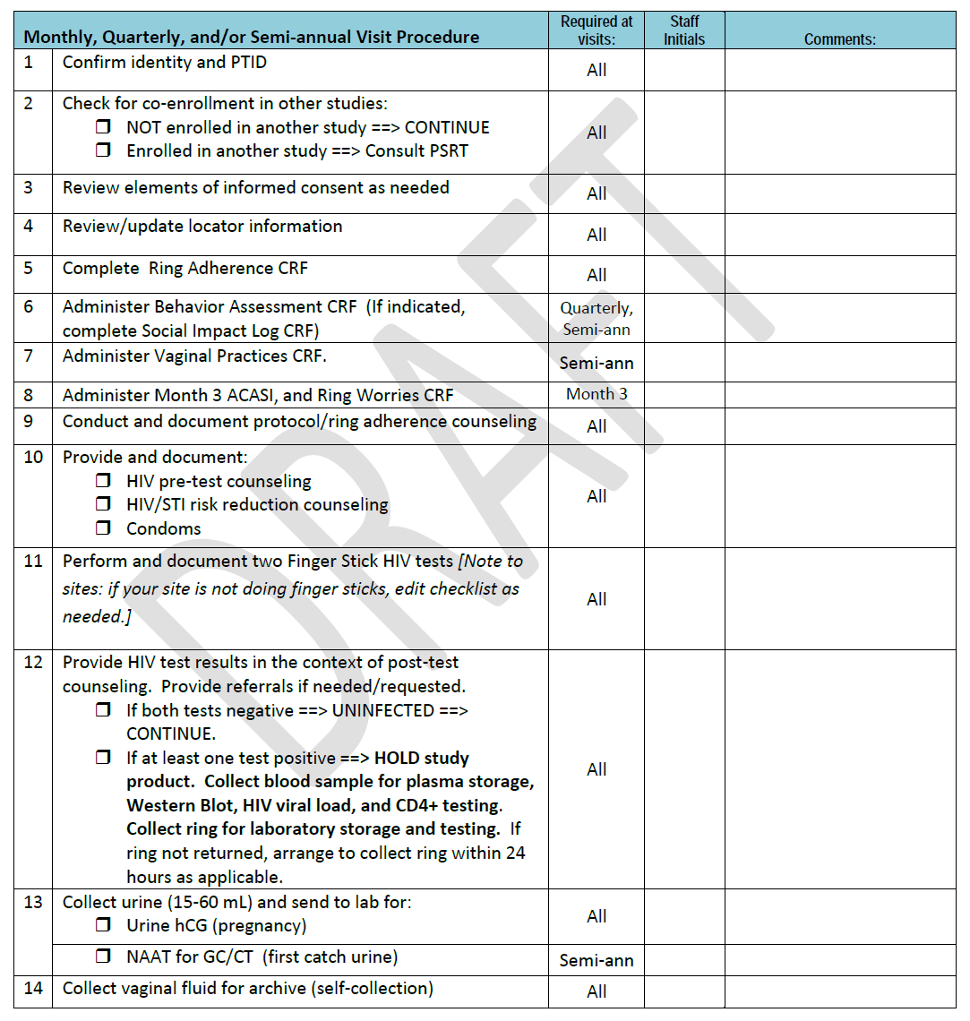
Visit Checklists
Notes:
Instructions: The “Required at visits” column indicates when the item is required during follow-up per-protocol. Procedures do not have to be conducted in the order in which they appear in the checklist. When an item is performed, complete “Staff Initials” cell. If not done but required, write “ND” and staff initials in “Staff Initials” cell, and provide more details in the chart notes as needed. Do not initial for other staff members. If other staff members are not available to initial items themselves, write and initial/ date a note documenting who completed the procedure, e.g., “done by {name}” or “done by nurse.” If visit procedures are split across more than one date, ensure the date is captured in the comments cell for procedures conducted on a date different than that provided above.
May act as source documentation for some procedures – see site specific SOPs

Slide 34
Sequence of Procedures
Modify to maximize efficiency of clinic flow
Very few procedures have required order:
Pelvic Exams
Behavioral Assessments before Counseling
Ideally, vaginal fluid swab with ring still in place
Ring provision toward end of visit (after clinical/lab assessments)
Recommend pairing Vaginal Ring (VR) removal/insertion
Flexibility is encouraged
Notes:
The sequence of procedures presented on the visit checklists is a suggested ordering.
In consultation with the MTN CORE (FHI 360), it is encouraged that site staff modify the checklists to maximize the efficiency of site-specific study operations.
Sites may alter the sequence of procedures, with the listed exceptions.
Can discuss/prompt for rationale:
Pelvic – sample collection order important
Neutral/unbiased assessments more likely b/f counseling (behavioral assessment include ACASI/questionnaires)
Fluid – want levels to reflective of past month (will spike with disturbance/new insertion); suggest pairing with urine collection
Ring towards end of visit – need to make sure product hold not required before dispensing
Pairing removal/insertion – less burden on participant

Slide 35
Clinic Flow
Why is efficiency important?
What are some strategies that may help improve clinic flow?
Regular internal reviews of systems is key - proactive rather than reactive
Notes:
Prompt audience with questions – quick, 1-2 minute brainstorm (nothing long). Can note after the brainstorm that will touch on clinic flow more during the retention session later in the day.
Why: study visit length has the potential to negatively impact both participants (i.e. experiences could lead to poor retention), and staff (i.e. stress, fatigue, longer hours, low morale)
Strategies: Minimizing movement (to/from waiting room) by grouping procedures, task sharing/shifting, have well trained/experienced staff (provide opportunities for training when needed), recognize/avoid bottlenecks, minimize waiting room time, reduce/avoid redundancies in procedures (i.e. if checklist is sufficient, don’t also chart note)

Slide 36
Follow-up Visits – Key CRFs

Slide 37
Follow-up Visit CRFs
Visit Summary
Ring Adherence
Monthly Laboratory Results
Family Planning
Ring Collection/Insertion
Follow-up LDMS Specimen Tracking Sheet (non-DataFax)
Visit Summary
Ring Adherence
Monthly Laboratory Results
Family Planning
Ring Collection/Insertion
Follow-up LDMS Specimen Tracking Sheet (non-DataFax)
Behavior Assessment
Quarterly Laboratory Results
Specimen Storage
Abbreviated Physical Exam
Visit Summary
Ring Adherence
Monthly Laboratory Results
Family Planning
Ring Collection/Insertion
Follow-up LDMS Specimen Tracking Sheet (non-DataFax)
Behavior Assessment
Quarterly Laboratory Results
Specimen Storage
Abbreviated Physical Exam
Vaginal Practices
Pelvic Exam
Pelvic Exam diagram (non-Data-Fax)
STI Results
Monthly
Visits
Quarterly
Visits
Semi-Annual
Visits

Slide 38
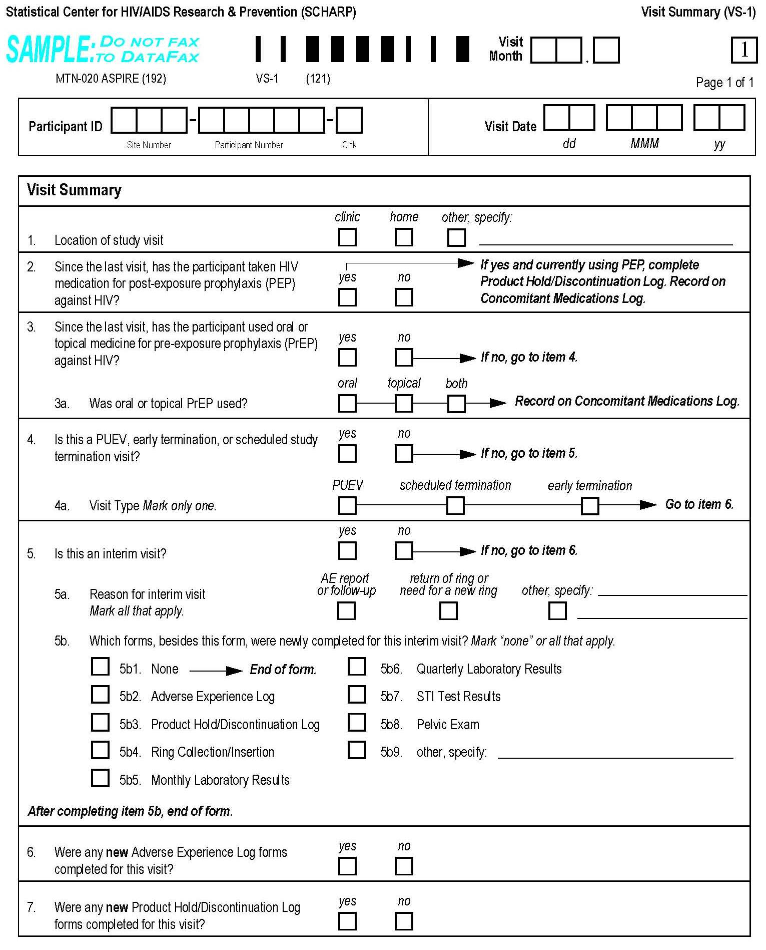
Monthly CRFs - Visit Summary
Page 219

Slide 39
Visit Summary CRF
Completed each time a required follow-up visit is completed
Captures information on location of visit, prompts for ppt’s use of PEP or PrEP since last visit (items 2-3 need to be completed during the visit)
Documents if this is the ppt’s PUEV, early termination, or termination visit
Asks if the visit in an interim visit (will talk about soon), and if so, which CRFs were newly-completed for the interim visit
For required visits, asks if any new AE Log pages or Product Hold/Discontinuation Log pages were completed
Just yes/no, number of pages completed not collected
For split visits, complete only 1 Visit Summary CRF on the first date of that visit

Slide 40
Monthly CRFs – Ring Adherence
Is not interviewer-administered (read aloud word-for-word), but is completed based on information obtained from the participant regarding her ring use
Completed at all required follow-up visits, even if ppt has been perm d/c from ring
If perm d/c, item 1 = no then end of form
Not completed at interim visits
Items 2-5 completed based on ppt self-report
Use ppt’s best estimates – does not have to be precise
Item 2 – try to include all times the ring has been out, including times removed and re-inserted by site staff at an interim visit
Item 5 – mark all reasons reported by the ppt
Grouped by whether ring was taken out or came out on its own
Notes:
Ring adherence
Make reference back to clinic flow discussion, that this assessment (and any other behavioral assessments) should occur prior to associated counseling during the visit.

Slide 41
Monthly CRFs -Family Planning – p.???
Item 1 – record all methods the ppt reports using since her last visit
Update Con Meds Log as needed
Item 2 – has the ppt had a complete period since last visit, or is she currently on menses? If yes, record start date and end date (or ongoing) in items 2a and 2b.
If no menses, mark “no” for item 2 and end of form
If “ongoing” (ppt is currently on menses), mark in 2b and do not update at later visits
Just want to capture menses status at time of visit

Slide 42
Other Monthly CRFs
Ring Collection and Insertion
Complete at interim visits as well if a ring was collected or dispensed
Will be discussed in detail during product use session
Monthly Laboratory Results
pregnancy, HIV rapid, stored plasma for HIV confirmation; self-collected vaginal swab
Follow-up LDMS Tracking Sheet
self-collected vaginal swab; blood for HIV seroconversion confirmation if a positive rapid HIV test result at the visit

Slide 43
Quarterly CRFs – Behavior Assessment – p.???
2 pages, interviewer-administered, local lang.
Similar questions as on BBA except no ring worries questions (asked at Month 3, PUEV)
Items 1-13 ask about sex partners, sex frequency, condom use
Item 14 – is ppt bothered wearing the ring?
Item 15 – social harm related to study participation in last 3 months; complete Social Impact Log CRF

Slide 44
Other Quarterly CRFs
Quarterly Lab results – like Screening Lab Results CRF
Hemogram, Differential, Chemistries
Abbreviated Physical Exam
Required assessments are same as at Enrollment Visit
Specimen Storage (p.239)
quarterly plasma, semi-annual pelvic gram stain and endocervical swab; used vaginal ring for storage
Follow-up LDMS Specimen Tracking Sheet

Slide 45
Additional CRFs for Month 3
Follow-up ACASI Tracking
Complete when ACASI done; required at Month 3 and at PUEV or at perm product d/c; item 2 = use to document any problems/issues with the questionnaire
Ring Worries
Completed at Month 3 and PUEV only
Interviewer-administered, in local language
Item 1 – how worried about wearing the ring every day
Item 2 – specific worries ppt may be having; read each aloud and ask for a yes/no response
Item 3 – completed only at PUEV/early termination; ppt’s thought on which product she was using (active or placebo)

Slide 46
Semi-Annual CRFs - Vaginal Practices
Completed at same visits as pelvic exams
Semi-annual, PUEV/early termination
Interviewer-administered, local language
Similar questions as Baseline Vaginal Practices
Items 4 and 5
Item 5d (whether ppt has inserted fingers to clean or insert something the past 3 months does not include Vaginal Ring insertion
Items 1-3 involve menses and ring use
Was ring worn during menses (even for just a part of menses)
How did the ppt like wearing the ring during menses

Slide 47
Semi-Annual CRFs cont’d
Pelvic Exam (p.249)
Similar to Screening Pelvic Exam CRF
STI Test Results
Similar to Screening STI Test Results

Slide 48
Any Questions At This Time?

